Slide 1

Heaven’s Light is Our Guide
Department of Computer Science & Engineering
Rajshahi University of Engineering & Technology
TENTATIVE TITLE : Brain Tumor Detection Using Image Processing and Convolutional Neural Network
Presented by
Saifur Rahman Shatil
Roll No.: 1503043
Dept. of CSE, RUET
Supervised by
Dr. Mir Md. Jahangir Kabir
Professor
Dept. of CSE, RUET

Slide 2
Outlines
Introduction
Objectives
Related Works
Background Study
Methodology
Implementation
Result
Challenges
Future Work
References

Slide 3
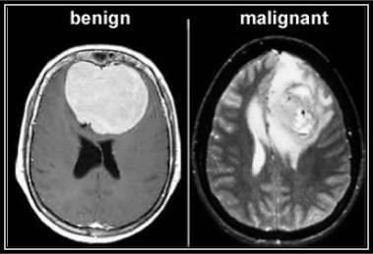
Introduction
Brain and other nervous system cancer is the 10th leading cause of death for men and women.[1]
The overall incidence rate of all brain tumors to be 10.82 (8.63-13.56) per 100 000 person-years[2]
Types
Benign
Malignant
Fig-01: Types Of Tumor

Slide 4
Objectives
To investigate recent works
To propose a new model or method
To implement the proposed model or method
To show a comparative study

Slide 5
Literature Review
Dong et al. Proposed Automatic Brain Tumor Detection and Segmentation using U-Net Based Fully Convolutional Network. [3]
Accuracy: 0.88
Dataset: BRATS 2015
Limitations:
Less Successful in Segmenting Enhancing Tumor regions.
No Bias Correction

Slide 6
Literature Review(Cont’d)
Pereira et al. Proposed Brain Tumor Segmentation Using Convolutional Neural Networks in MRI Images. [4]
Accuracy: 0.88
Dataset: BRATS 2015
Limitations:
Only Rotational Data Augmentation

Slide 7
Literature Review(Cont’d)
Zhao et al. Proposed A Deep Learning Model Integrating FCNNs and CRFs for Brain Tumor Segmentation. [5]
Accuracy: 0.87
Dataset: BRATS 2013
Limitation:
Requires more training samples

Slide 8
Literature Review(Cont’d)
What are the differences between them?

Slide 9
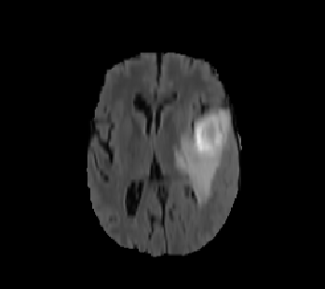
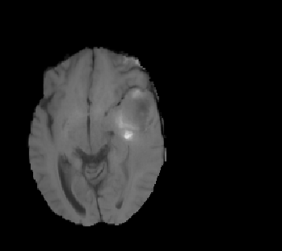
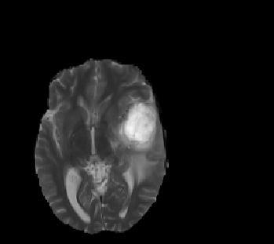
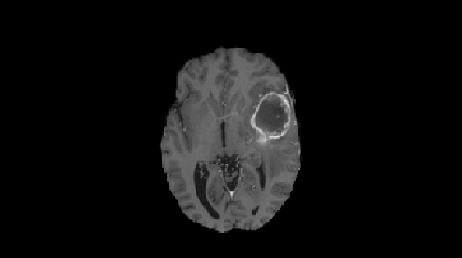
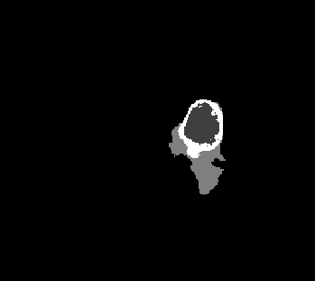
Background Study
Dataset (BRATS):
Fig-02: Flair, T1, T2
T1c, GT [6]

Slide 10
Background Study(Cont’d)
Why CNN?[7]
Fast During Testing
Bigger Dataset
Superior Feature Extraction

Slide 11
Background Study(Cont’d)
How Convolution Works?
Fig-03: Convolution Illustration [8]

Slide 12
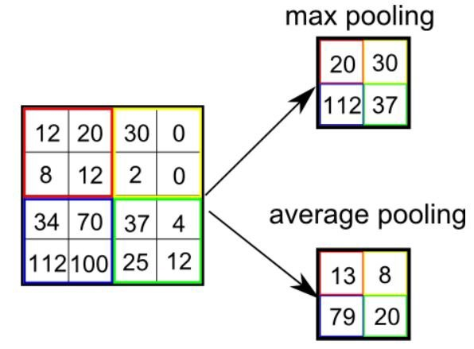
Background Study(Cont’d)
How Pooling Works?
Fig-04: Pooling Illustration [8]

Slide 13
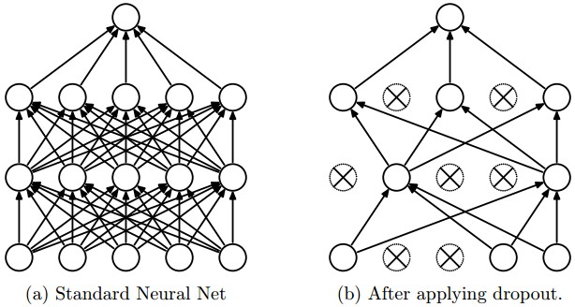
Background Study(Cont’d)
Why Dropout is Needed?
Fig-05: Dropout illustration [9]

Slide 14
Background Study(Cont’d)
Quick Review on CNN
Convolution Layer
ReLu Layer
Pooling Layer
Fully connected layer

Slide 15
Background Study(Cont’d)
Different CNN Architectures[8]:
LeNet
AlexNet
VGGNet
ResNet

Slide 16
Methodology
Fig-07: Steps of the approach
Input MRI Image
Gray Scale Conversion
De-Noising
Intensity
Normalization
Trained Model
Fed the images into CNN to train
Spilt Data into Training and Validation
Augmentation
Test The model with preprocessed test images
Detect Normal or abnormal and show accuracy

Slide 17
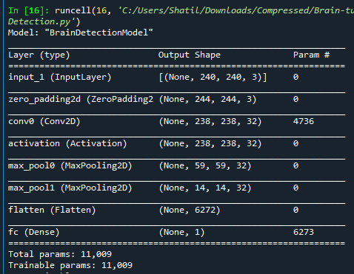
Implementation
Model:
Fig-08: Model Details

Slide 18
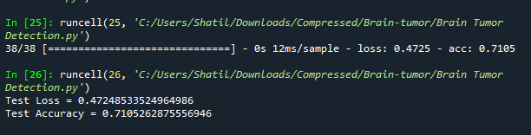
Result
Fig-10: Test Data Result

Slide 19
Challenges
To Work with BRATS dataset.
Finding the best CNN architecture.

Slide 20
Future Work
Try to implement the proposed model
Improve detection accuracy.

Slide 21
Summary
In this presentation I have tried to present
The current research work on this field
About CNN
Workflow & Implementation
Challenges and Future Work

Slide 22
References
https://www.cancer.net/cancer-types/brain-tumor/statistics
Robles, Paula & Fiest, Kirsten & Frolkis, Alex & Pringsheim, Tamara & Atta, Callie & St.Germaine-Smith, Christine & Day, Lundy & Lam, Darren & Jette, Nathalie & Hotchkiss, N. (2014). The worldwide incidence and prevalence of primary brain tumors: A systematic review and meta-analysis. Neuro-Oncology. 17. 1-8. 10.1093/neuonc/nou283.
Dong, H., Yang, G., Liu, F., Mo, Y., & Guo, Y. (2017). Automatic Brain Tumor Detection and Segmentation Using U-Net Based Fully Convolutional Networks. Medical Image Understanding and Analysis, 506–517. doi:10.1007/978-3-319-60964-5_44
S. Pereira, A. Pinto, V. Alves and C. A. Silva, "Brain Tumor Segmentation Using Convolutional Neural Networks in MRI Images," in IEEE Transactions on Medical Imaging, vol. 35, no. 5, pp. 1240-1251, May 2016. doi: 10.1109/TMI.2016.2538465

Slide 23
References(Cont’d)
5. Zhao, X., Wu, Y., Song, G., Li, Z., Zhang, Y., & Fan, Y. (2018). A deep learning model integrating FCNNs and CRFs for brain tumor segmentation. Medical image analysis, 43, 98–111. doi:10.1016/j.media.2017.10.002
6. Menze et al., The Multimodal Brain TumorImage Segmentation Benchmark (BRATS), IEEE Trans. Med. Imaging, 2015.
7. https://www.quora.com/Which-is-best-between-SVM-and-NN-in-image-processing
8. https://towardsdatascience.com/a-comprehensive-guide-to-convolutional-neural-networks-the-eli5-way-3bd2b1164a53
9. https://leonardoaraujosantos.gitbooks.io/artificial-inteligence/content/dropout_layer.html

Slide 24
Thank you

